Slide 1

Open Headset Interconnect Standard
Mark Smith, N6MTS

Slide 2


Who am I?
Mark Smith, N6MTS
Head Cheese, Halibut Electronics: https://electronics.halibut.com/
A host of the Ham Radio Workbench Podcast:
https://www.hamradioworkbench.com/
Twitter and YouTube: @SmittyHalibut
Mastodon/Fediverse: @smitty@halibut.com
Video

Slide 3
Who am I?
Ham: Active ham since 1992.
College: Two years in Electrical Engineering, but degree in Computer Engineering
Work: 25 years in IT, Network and Unix Systems Engineering, and Information Security.
All Three: Left IT in 2021, started Halibut Electronics to make Ham Radio and Audiophile electronics.
First big product, SOAR: Satellite Optimized Amateur Radio. Available late 2022.
Video

Slide 4
Open Headset Interconnect Standard
Open: Any individual or company may make devices compliant with this standard, with no obligation.
Headset: Describes the signaling commonly found between a user and a radio: Microphone, Headphones, and Push To Talk.
Interconnect: Describes both the physical and electrical connection of those signals between the user and radio.
Standard: Devices built to this standard will work with other devices built to the same standard.
Video

Slide 5
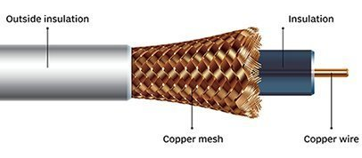
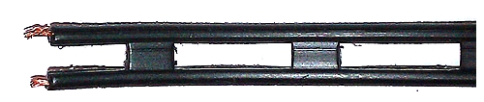
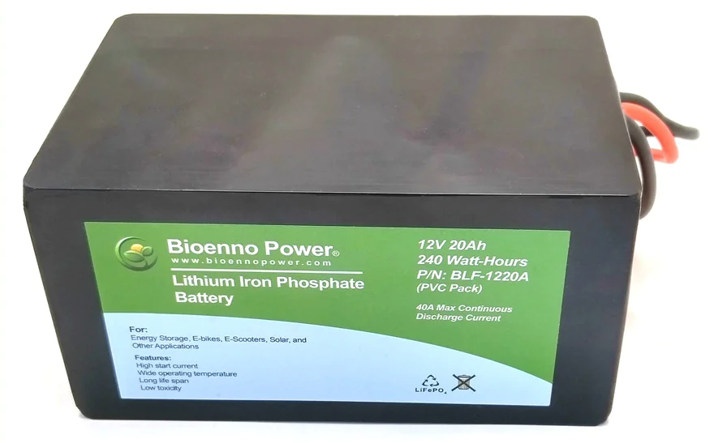
Standards
We have electrical standards (defined, or defacto) for things like RF and Power:
RF: 50 ohm impedance coax, 450 ohm twin lead
Power: +13.8vDC +/- 15%
Video

Slide 6
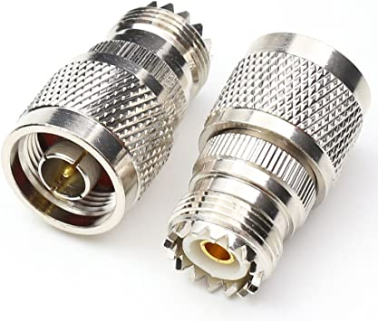
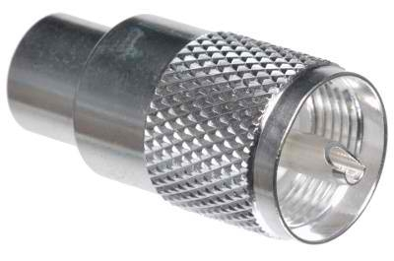
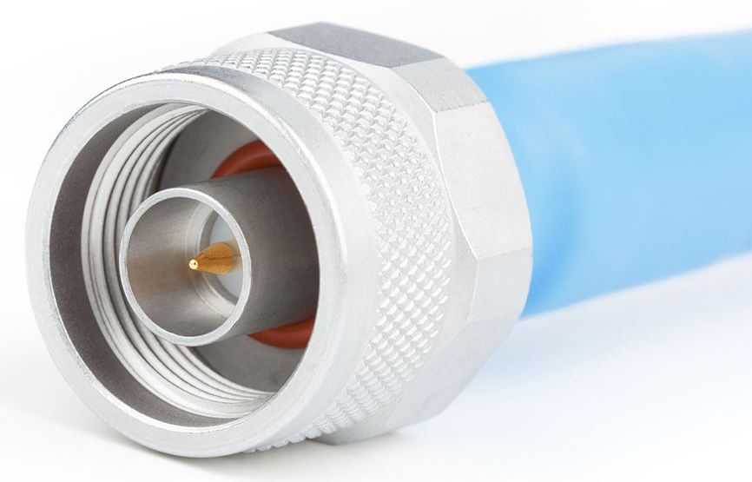
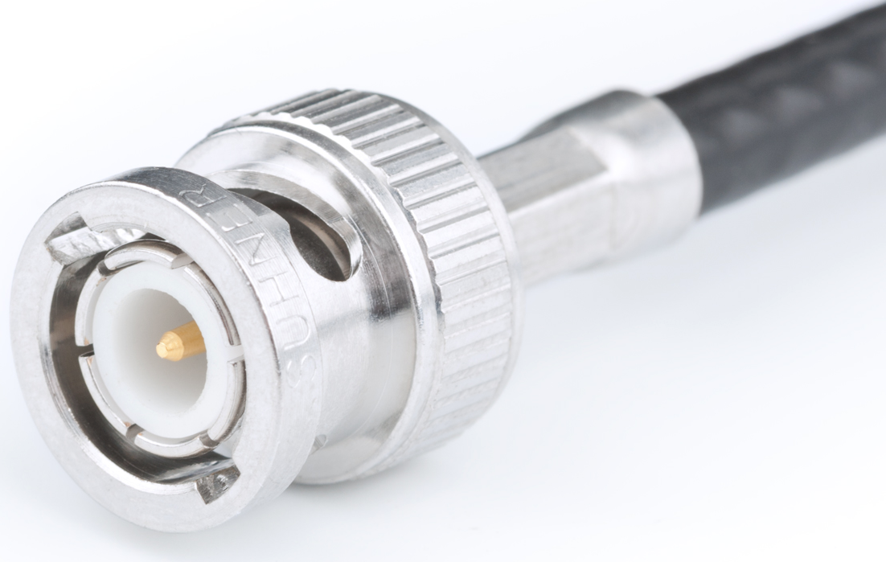
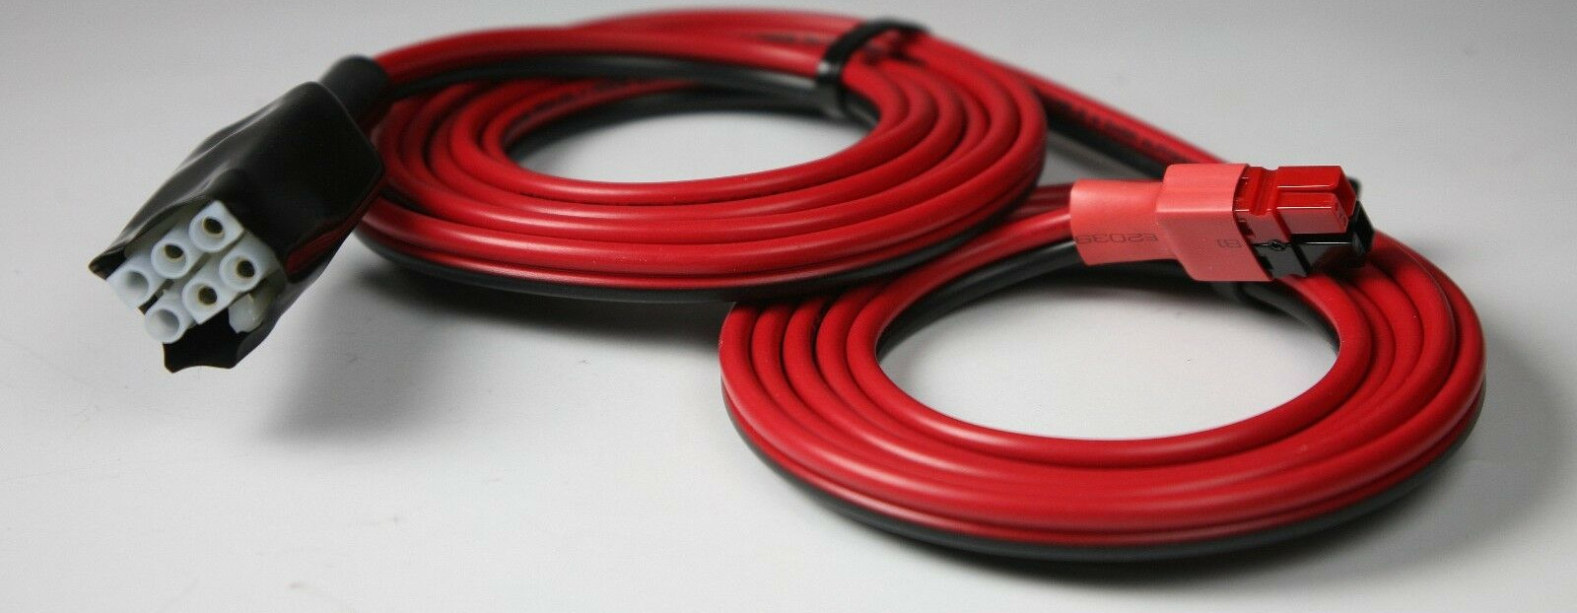
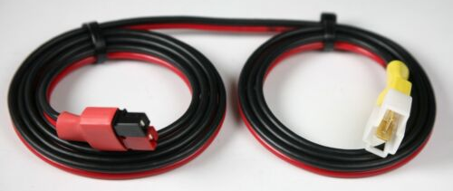
Standards
And one, or a few, physical standards that are easy to convert between:
RF: PL-259, Type N, BNC, etc
Power: Powerpole, 6-pin “Molex”, “T” blades, etc
Video

Slide 7
Standards?
No such electrical standards exist for the User to Radio interface:
Microphone: Dynamic, Electret, or Carbon? Balanced or single ended?
Audio out: Headphone level, speaker level, or line level? Ground referenced or push-pull? Mono or stereo?
PTT: GPIO style contact closure to ground, or completing the mic circuit?
Video

Slide 8
So many to choose from!
There are even more physical options to choose from!
Microphone: 3.5mm TS/TRS? ¼” TS/TRS? XLR? “8-pin round” Aviation? 8 pin modular? 6 pin modular? What pinout?
Audio out: 3.5mm TS/TRS? ¼” TS/TRS?
PTT: On the mic connector? 3.5mm TS? ¼” TS?
Video

Slide 9
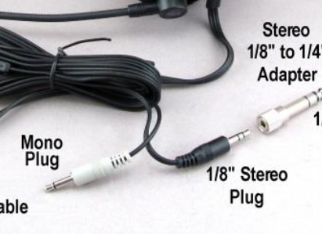
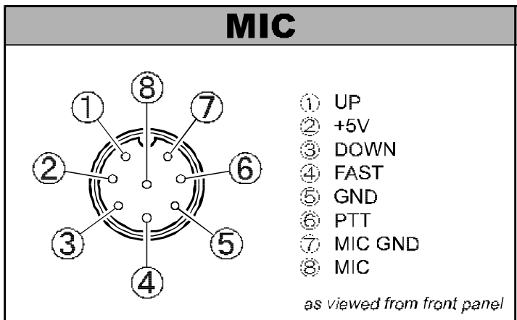
The problem is...
Heil Pro 7 Headset:
Yaesu FT-920 Microphone pinout:
Video

Slide 10
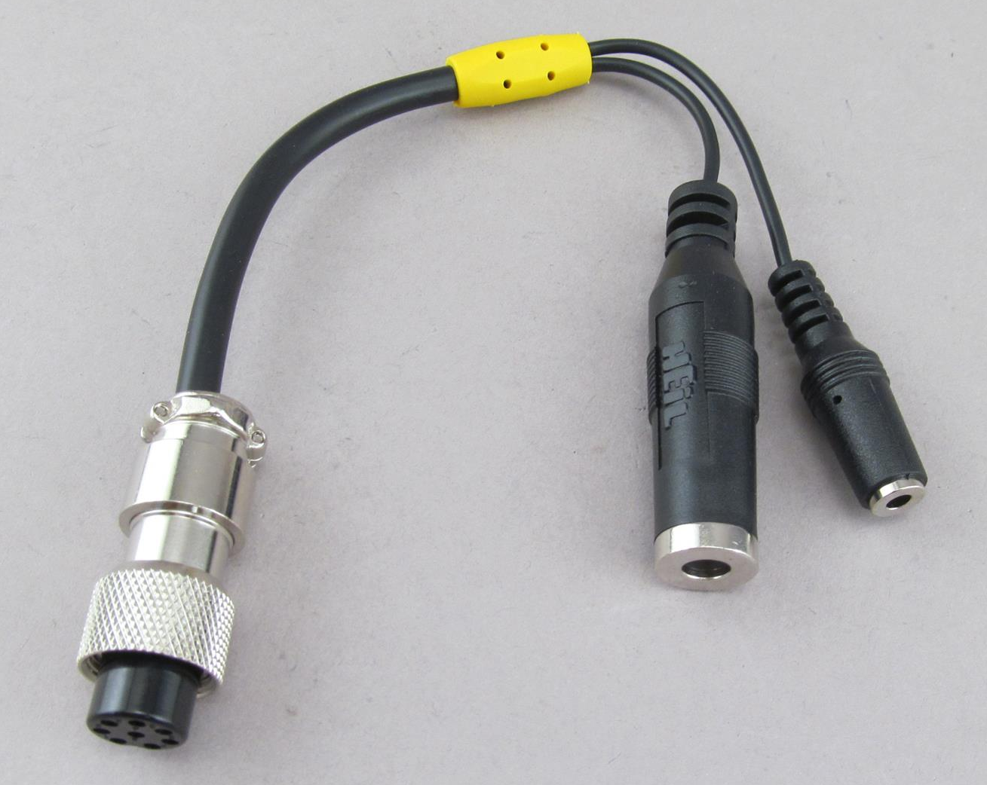
The solution?
Heil AD-1-Y Adapter:
Yaesu FT-920 Microphone pinout:
Heil Pro 7 Headset:
Yaesu FT-920 Microphone pinout:
Video

Slide 11
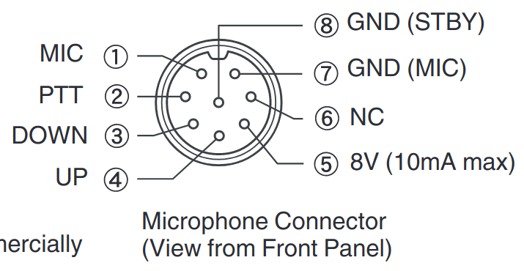
But, I’ve got a Kenwood too.
Yaesu FT-920 Microphone pinout:
Kenwood TS-890S Microphone pinout:
Yaesu FT-920 Microphone pinout:
Kenwood TS-890S Microphone pinout:
Video

Slide 12
But, I’ve got a Kenwood too.
Heil Pro 7 Headset:
Kenwood TS-890S Microphone pinout:
Video

Slide 13
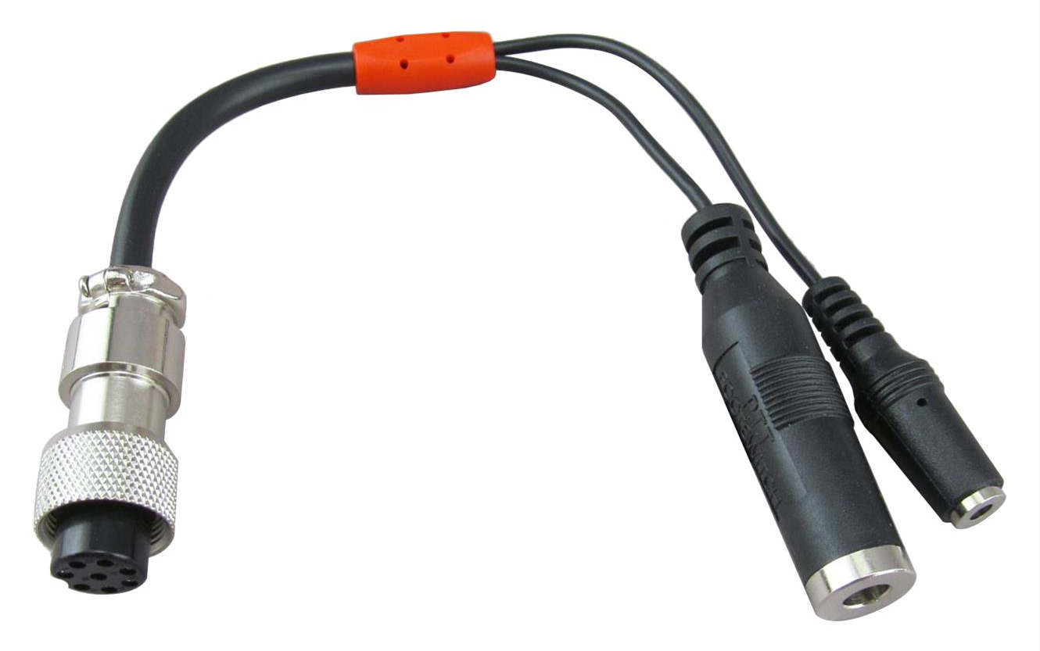
Bob has me covered...
Heil AD-1-K Adapter:
Heil Pro 7 Headset:
Kenwood TS-890S Microphone pinout:
Video

Slide 14
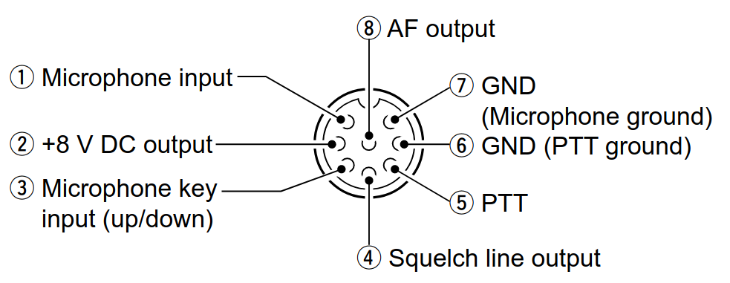
What about Icom?
Heil Pro 7 Headset:
Icom IC-7300 Microphone pinout:
Video

Slide 15
Same connect-- oh… Never mind...
Yaesu FT-920 Microphone pinout:
Icom IC-7300 Microphone pinout:
Kenwood TS-890S Microphone pinout:
Video

Slide 16
What about Icom?
Heil Pro 7 Headset:
Icom IC-7300 Microphone pinout:
Video

Slide 17
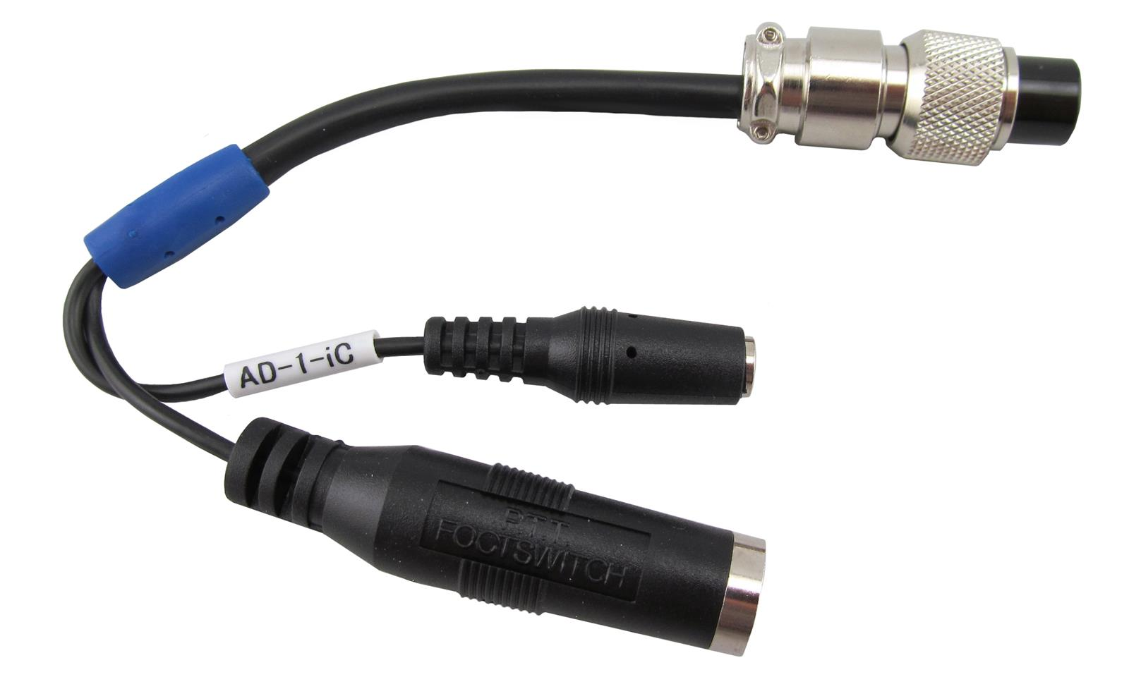
Bob still has me covered...
Heil AD-1-iC Adapter:
Heil Pro 7 Headset:
Icom IC-7300 Microphone pinout:
Video

Slide 18
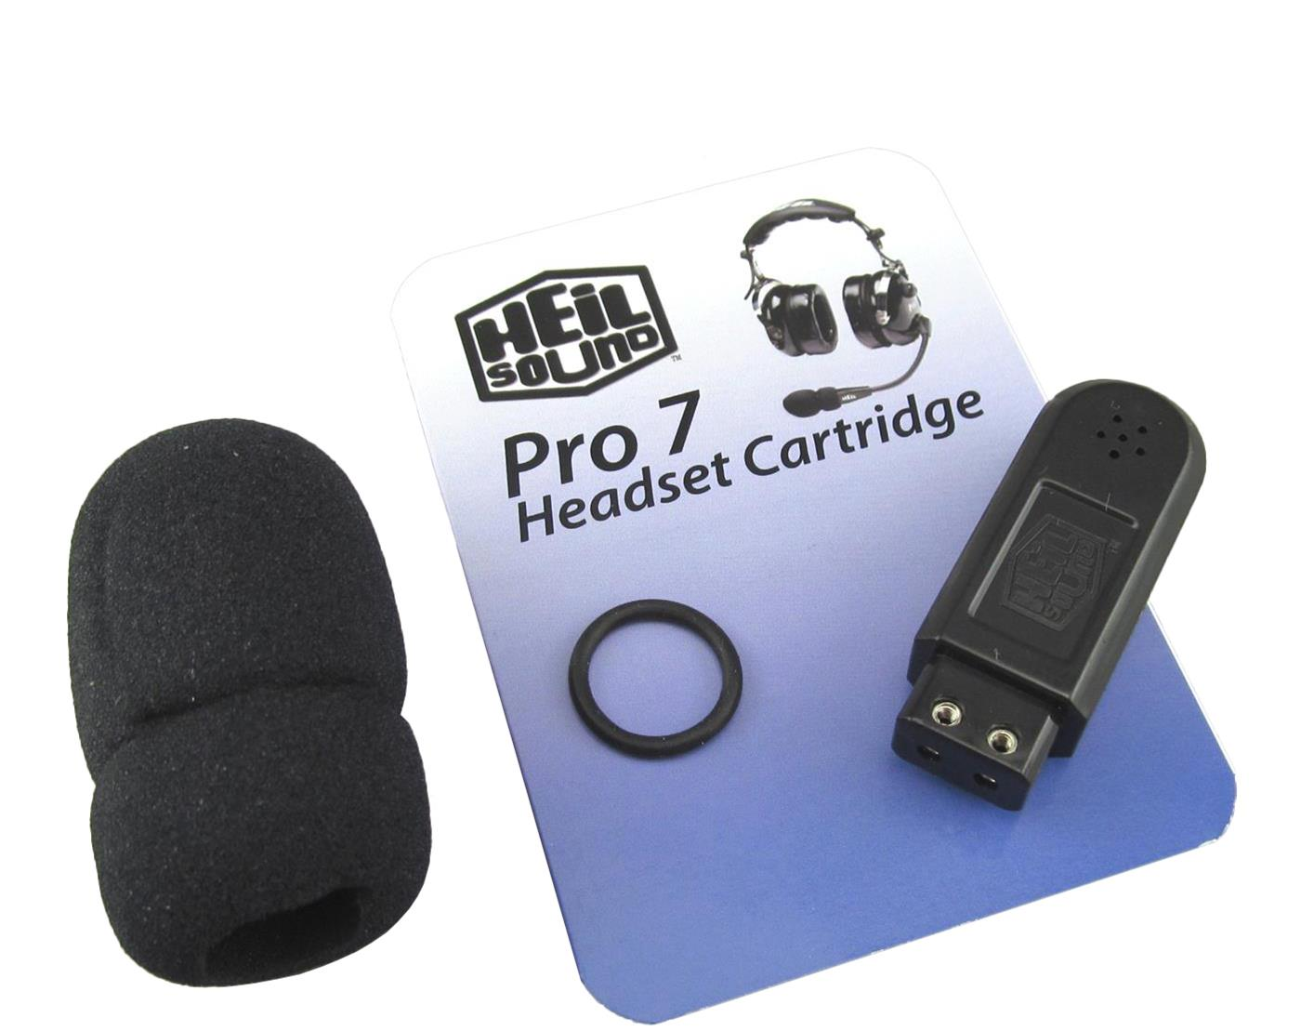
But, wait a minute...
Heil AD-1-iC Adapter:
Heil Pro 7 Headset:
Icom IC-7300 Microphone pinout:
Heil P7-IC-ELEM Microphone Element:
Video

Slide 19
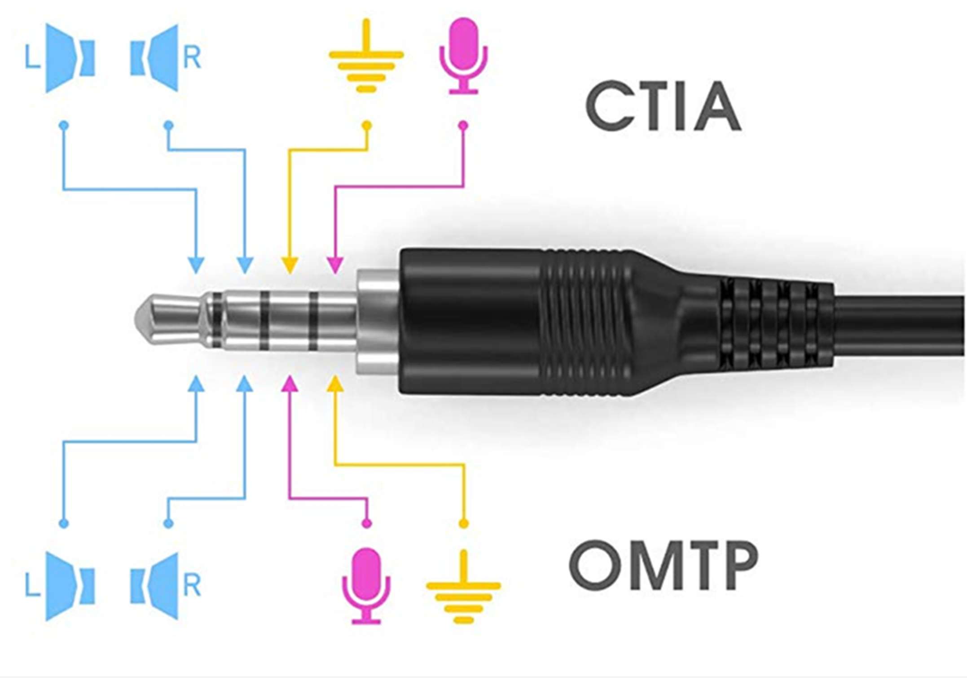
Another headset,
CTIA “PC Gaming Headset”
or “Mobile Phone” pinout:
Yaesu FT-920 Microphone pinout:
Video

Slide 20
Another headset, 3 more adapters...
CTIA “PC Gaming Headset”
or “Mobile Phone” pinout:
Yaesu FT-920 Microphone pinout:
Kenwood TS-890S Microphone pinout:
Icom IC-7300 Microphone pinout:
Video

Slide 21
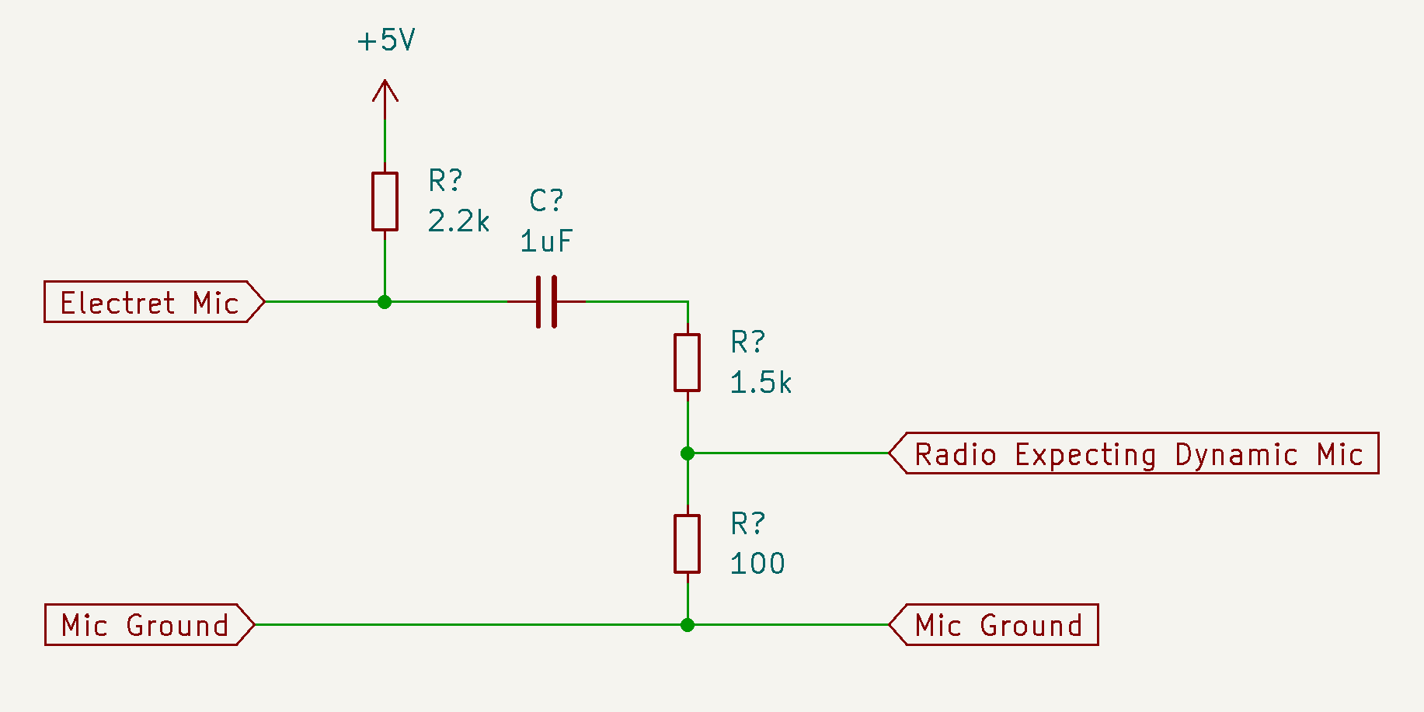
“Your audio is distorted!”
CTIA “PC Gaming Headset”
or “Mobile Phone” pinout:
Yaesu FT-920 Microphone pinout:
Video

Slide 22
Which 3.5mm TRRS was that?
CTIA “PC Gaming Headset”
or “Mobile Phone” pinout:
Video

Slide 23
Which 3.5mm TRRS was that?
CTIA “PC Gaming Headset”
or “Mobile Phone” pinout:
Video

Slide 24
Your Adapter Game is strong.
This is quickly getting out of hand.
It’s a full mesh of adapters, from every different headset to every different radio.
How do we address this?
Video

Slide 25
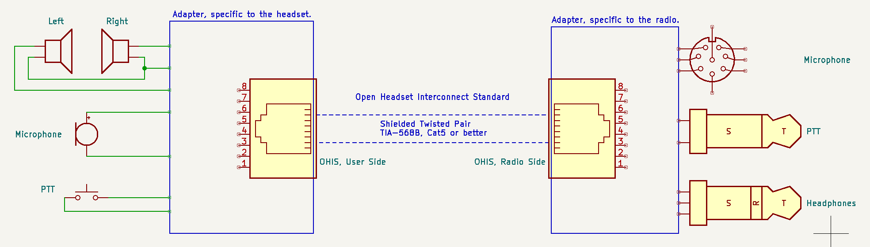
Open Headset Interconnect Standard
User side adapter: Specific to the headset, stays with the headset.
Radio side adapter: Specific to the radio, stays with the radio.
Open Headset Interconnect Standard is the connection between them.
Video

Slide 26
Technical Summary
Physical:
Connector: 8P8C Modular. (Commonly, but incorrectly, known as RJ-45.)
Cable: Cat5 or better. Shielded is preferred but not required.
Wiring: TIA-568A or 568B. Which pins pairs are on is important.
Allows the use of common off-the-shelf Ethernet cables.
Video

Slide 27
Technical Summary
Electrical:
Microphone: Electret level. +5vDC bias provided by Radio.
Audio Out: Ground referenced, “Headphone” level, stereo.
PTT: Simple contact closure to ground.
Power: +5vDC 200mA provided by Radio for audio amplifiers, LED indicators, signal processing, etc.
Video

Slide 28
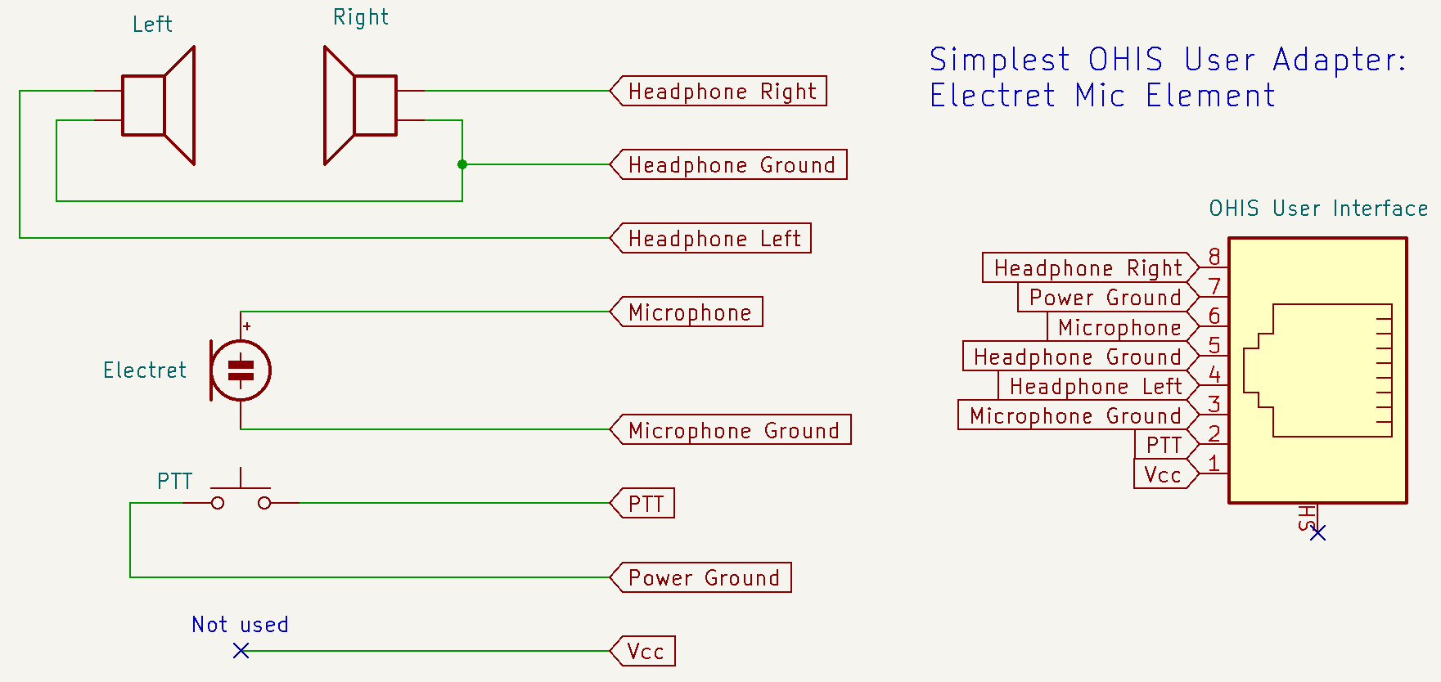
Technical Summary
Pin-out:
Video

Slide 29
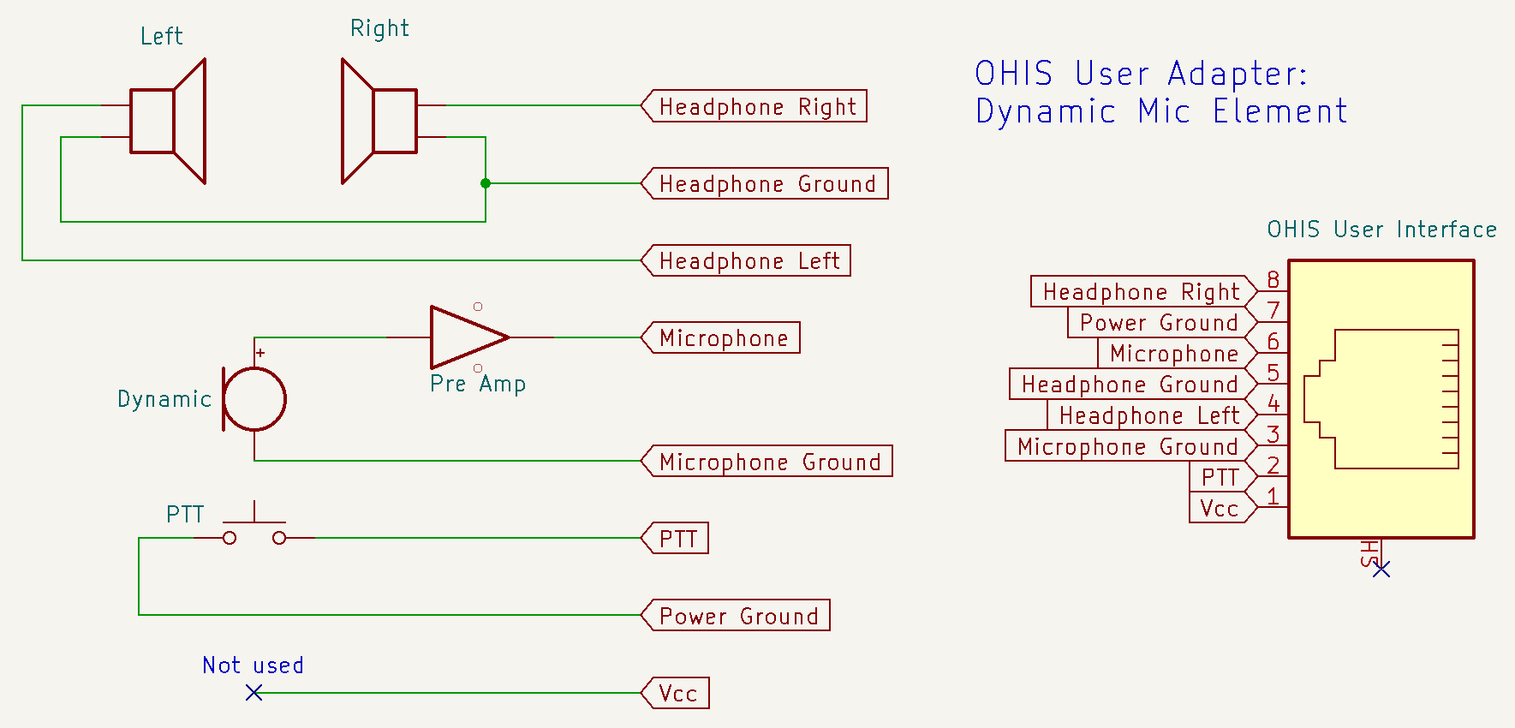
Technical Summary
Pin-out:
Video

Slide 30
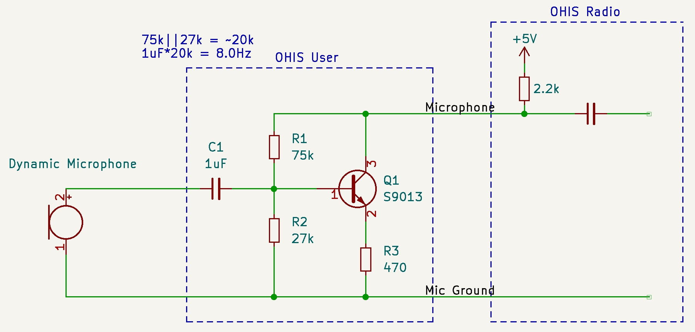
Dynamic Mic Preamp
Video

Slide 31
Technical Details...
See the QR codes for the Standard Document, the Groups.io email list and GitHub repository at the end of this presentation.
Video

Slide 32
When is OHIS useful?
When you have several different radios and headsets.
When you operate in a shared environment and users have their own (different) headsets.
  Examples: Field Day, club shack, or an Emergency Operations Center.
When you want to design and sell a device that goes between the User and the Radio, and have it work everywhere without overly complex input and output interfacing. ahem
Video

Slide 33
When is OHIS over-kill?
When you only have one radio, or one headset, or any situation where the “full mesh” problem doesn’t apply.
When you already have all the adapters you need.
When you prefer the simplicity of a single adapter between you and your radio.
Video

Slide 34
Why an Open Standard?
Open is how we get out of this mess.
Halibut Electronics needed to solve this problem for future products.
I am not Gillette.
This is a good DIY project, and I love DIY projects
Video

Slide 35



Learn more
The Standard document:
https://halibut-electronics.github.io/Open-Headset-Interconnect-Standard/Open-Headset-Interconnect-Standard.pdf
GitHub repository:
https://github.com/Halibut-Electronics/Open-Headset-Interconnect-Standard
Groups.io mailing list:
https://halibut-electronics.groups.io/open-headset-interconnect-standard/
Video

Slide 36
Questions and Answers
Beginning now

Slide 37
Slide Title
Slide Content
Video

